Slide 1

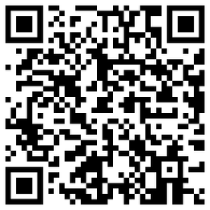


1056: DeepGF: Glaucoma Forecast Using the Sequential Fundus Images
Xiaofei Wang⁺, Liu Li⁺, Mai Xu*, Hanruo Liu, Ximeng Chen Beihang University (BUAA)
BUAA
Notes:
Hello everyone, this is Xiaofei, from Beihang university. Now I‘m going to introduce our miccai’s work,

Slide 2
1
Motivation
2
Database
Catalogue
3
Method
4
Experiment
Notes:
This introduction is consists of 4 parts, that is

Slide 3
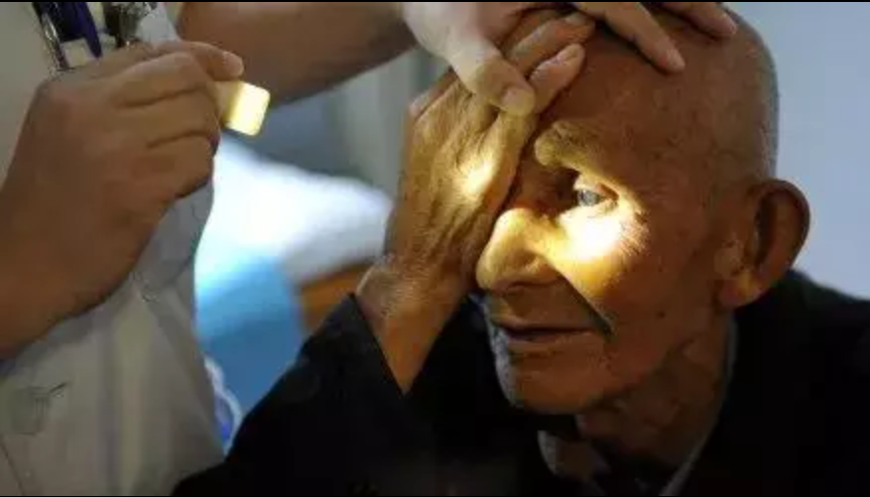
01
Motivation
Glaucoma: leading cause of irreversible blindness
3.5% incidence over 45 years old people
80 million patients all over the world in 2020
60 billion financial loss every year in china
80% blindness can be avoided through early detection and treatment
Notes:
Firstly, our work focuses on the task of glaucoma forecast, which aims to predict the potential of contracting glaucoma in the future, utilizing the variation tendency from the historical data.
And glaucoma is one of the leading cause of irreversible blindness. The incidence of glaucoma is 3.5 percentage over 45 years old people, which equals to around 80 million patients all over the world.
Fortunately, 80 percentage of the blindness can be avoided through early detection and treatment. So we are looking for an efficient early warning method for glaucoma.

Slide 4
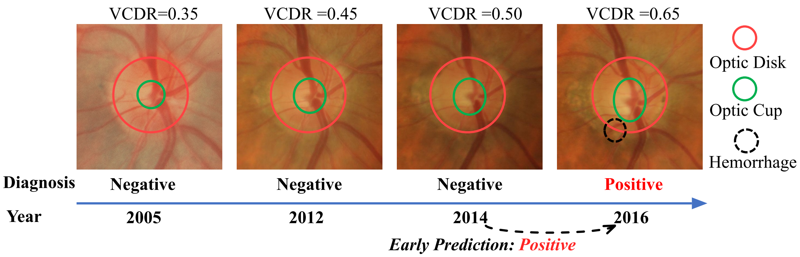
01
Motivation
Disease forecast: predicting the potential of contracting a disease in the future

Slide 5
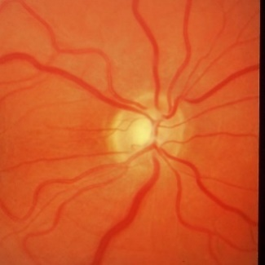
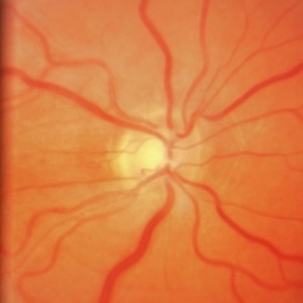
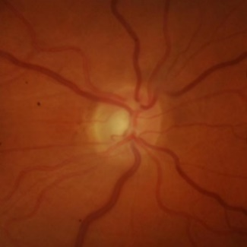
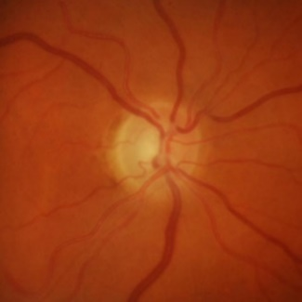
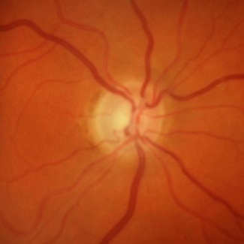
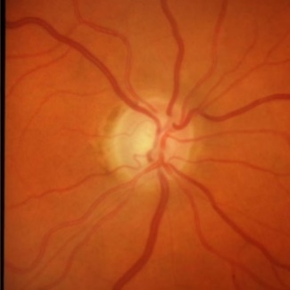
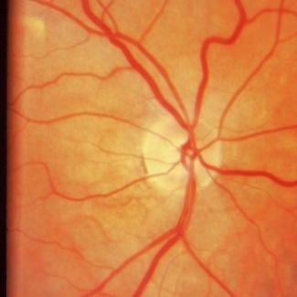
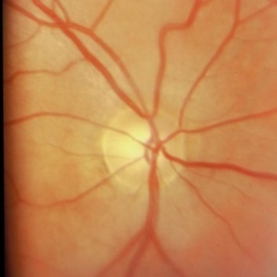
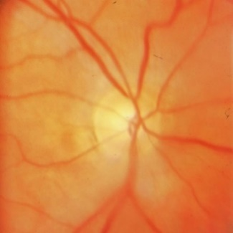
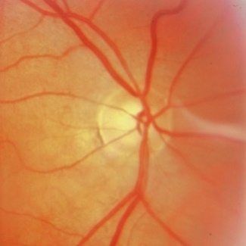
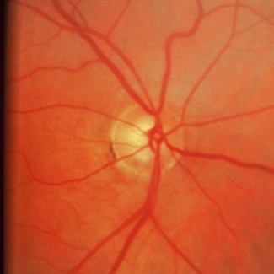
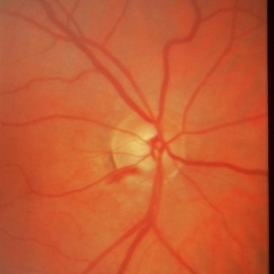
02
SIGF Database
Sequence number: 405 sequences, at least 6 fundus images in each sequence
Image number: 3,671 fundus images, an average of 9 fundus images per sequence
Patient1
2009/06
2010/02
2012/02
2014/04
2015/07
2016/08
Patient2
1993/05
1995/06
2000/05
2004/03
2007/04
2010/01
Negative
Positive
Time
Notes:
To drive a deep learning method for glaucoma forecast, a sequential fundus image database is required. However, To our best knowledge, there is no existing database designed for the forecast task.
So that in this paper, we firstly establish a sequential fundus images database for glaucoma forecast, called SIGF.
It contains 405 image sequences from different eyes, and each eye has at least 6 fundus images captured at different years, with an average of 9 images per eye, corresponding to 3,671 images in total.
Each images in our database is labeled with positive or negative glaucoma by 3 ophthalmologist. ofsa
Now The SIGF database is available in github under request, and you can find the download link in our paper or through the QR code in this page.

Slide 6
03
Method
1. DeepGF structure
(1) Attention-polar CNN（AP-CNN）：extract spatial features
(2) Variable time interval LSTM（VTI­LSTM）：extract temporal characteristics
Notes:
Then, based on our database, we propose a DeepGF network, which is consisted by two parts: the Attention-polar CNN subnet and Variable time interval LSTM subnet.
Specifically, the AP-CNN is composed of 2 parts: the attention subnet and the polar subnet.
Specifically, the attention subnet is proposed to remove the redundant regions on the fundus images by masking an attention map on both the input fundus images and the extracted feature maps.
As a result, the key features for glaucoma forecast can be highlighted
Besides, the polar subnet shares the same structure with the attention subnet, but the input of polar subnet is the ROI of the fundus images in polar coordinates.
The motivation to introduce polar coordinates is that such mapping can enlarge the optic cup regions, which is effective in finding the larger VCDR, and also a way for data augmentation.
Finally, the features extracted by the attention and polar subnets are concatenated as the final spatial feature.
More details about the CNN structure can be found in our paper.
Subsequently, the 2-layer VTI-LSTM is designed to learn the dynamic glaucoma transition.
In contrast to the traditional LSTM, the length of variant time interval is further encoded into the forget gate of the VTI-LSTM.
Finally, the output from the second VTI-LSTM layer is fed into the fully connected layer to obtain the final forecast output probability.

Slide 7
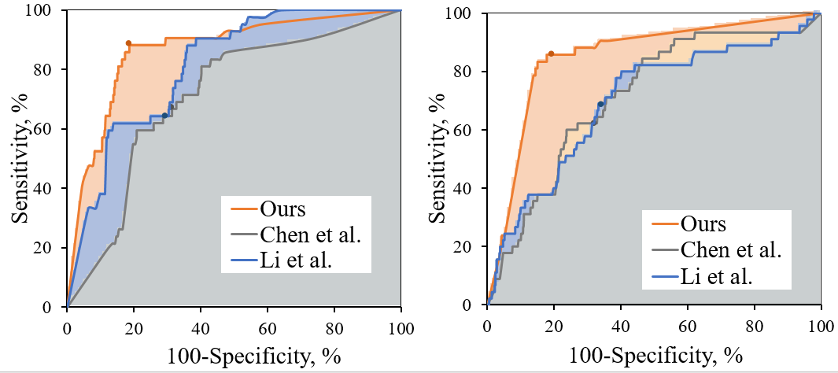
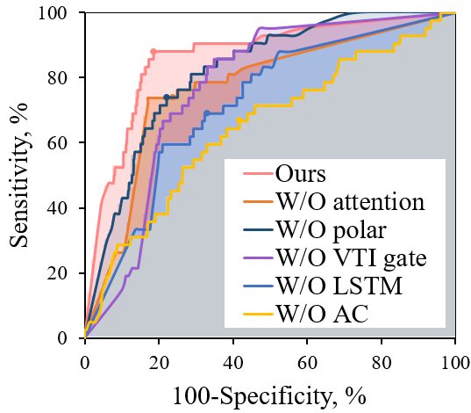
04
Experiment
Evaluation
Glaucoma forecast ablation results of DeepGF
Methods | ACC (%) | Sensitivity (%) | Specificity (%) | AUC
DeepGF (Full) | 80.7 | 85.7 | 80.6 | 0.870
Li et. al. | 66 | 68.9 | 65.9 | 0.7
Chen et. al. | 67.6 | 62.2 | 67.8 | 0.718
W/O attention subnet | 76.0 | 73.8 | 76.0 | 0.809
W/O polar subnet | 77.8 | 73.8 | 77.9 | 0.816
W/O VTI gate | 73.2 | 73.8 | 73.1 | 0.808
W/O LSTM | 67.1 | 69.0 | 67.1 | 0.749
W/O AC （replaced by data augmentation） | 58.4 | 66.7 | 58.2 | 0.648
ROC of glaucoma forecast and ablation experiment
Verifying the effectiveness of DeepGF
Notes:
In the experiment part, we compare the glaucoma forecast performance with two other methods, The quantitative results are shown in table right.
We can see that our DeepGF method outperforms the comparison methods in all terms,
and, the ROC curves in Figure right further visualizes the trade-off between sensitivity and specificity. And our ROC curve is closer to the upper-left corner than other two methods., which verifies that our DeepGF method is effective in forecasting glaucoma.
And also we investigate the impact of each part in our DeepGF model through ablation experiments, and the results are also shown in this page.
More details about the implementation can be found in our paper.

Slide 8
04
Experiment
4. Evaluation
Manually labeled:
Optic cup
Rim-loss
1
0
Visualization results of DeepGF for glaucoma forecast
Verifying the interpretability of DeepGF
Notes:
Besides, An additional visualization experiment is conducted by the CAM-based method for glaucoma forecast. As shown in this page,
the visualization result focuses on the potential pathological rim-loss regions and the optic cup regions, which also verifies the interpretability /in'tə:prətəbl/
of our DeepGF method for glaucoma forecast.
To conclude,

Slide 9
Thanks for your listening
1056: DeepGF: Glaucoma Forecast Using the Sequential Fundus Images
Notes:
Thanks for your listening and welcome to our poster session

Slide 10
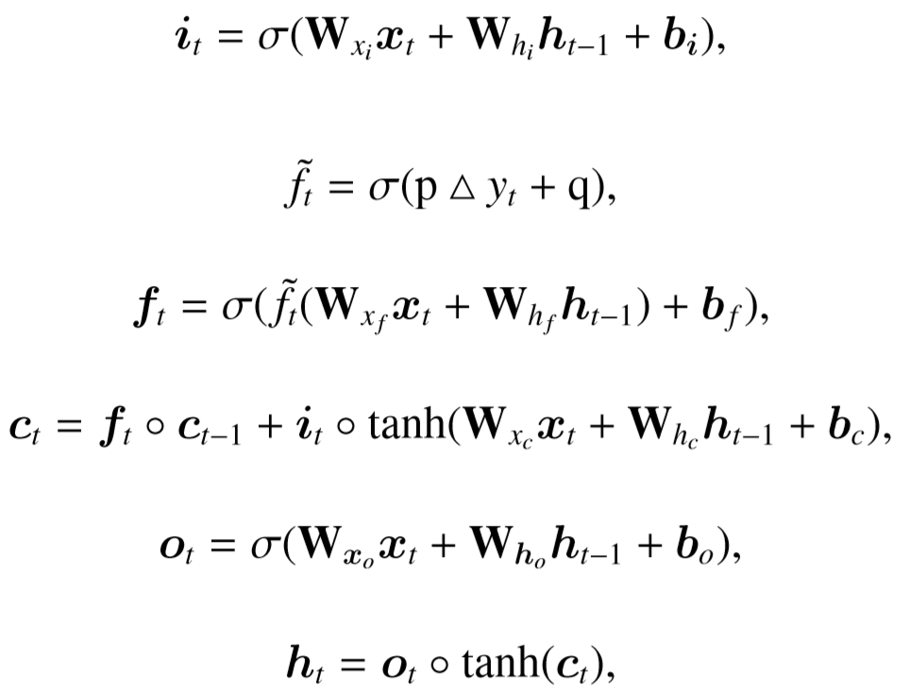
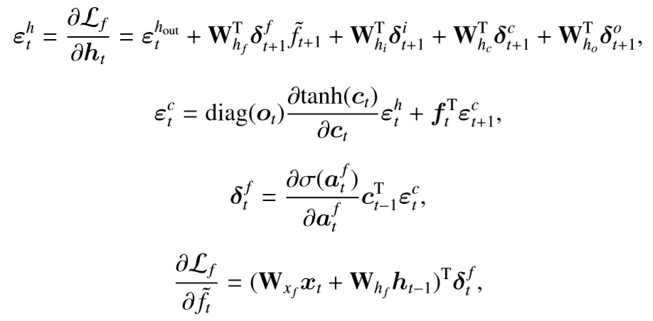
03
Method
2. VTI-­LSTM: extract the temporal information with variable time interval
VTI-­LSTM formulation：
Gradient of the VTI gate:
Input gate
VTI gate
Forget gate
Cell state
Output gate
Hidden state
BUAA
Notes:
Here are the mathematical equations for VTI-LSTM. We added a VTI gate term into the input

Slide 11
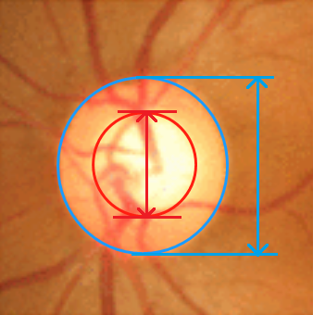
03
Method
2. AP-CNN of attention and polar subnet
Polar transformation to enlarge the pathological region
A way for data augmentation
(1) Medical prior
(2) Input of the polar subnet
VCDR
ROI
ROI-Polar
①
②

Slide 12
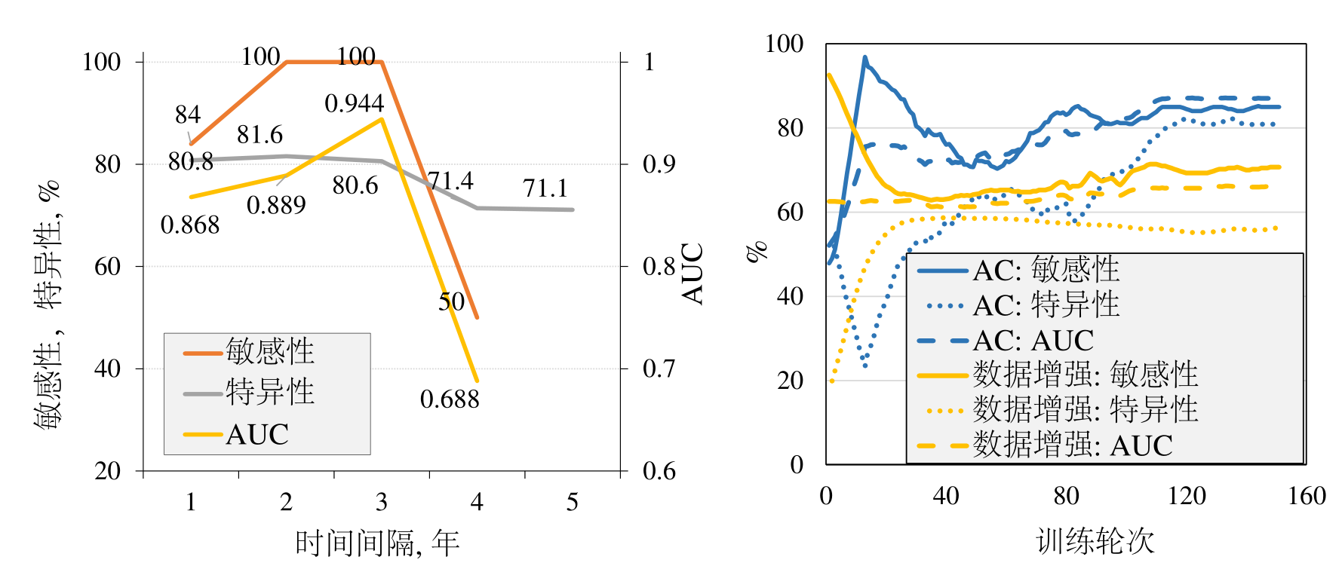
02
研究内容三
建库及数据分析
网络模型
动态收敛
实验结果
分级实验分析：
Optic cup
Rim-loss
1
0
图1. 测试序列在不同时间间隔下的青光眼预测性能
图2.不同训练策略的性能对比
Visualization results of DeepGF for glaucoma forecast
BUAA

Slide 13
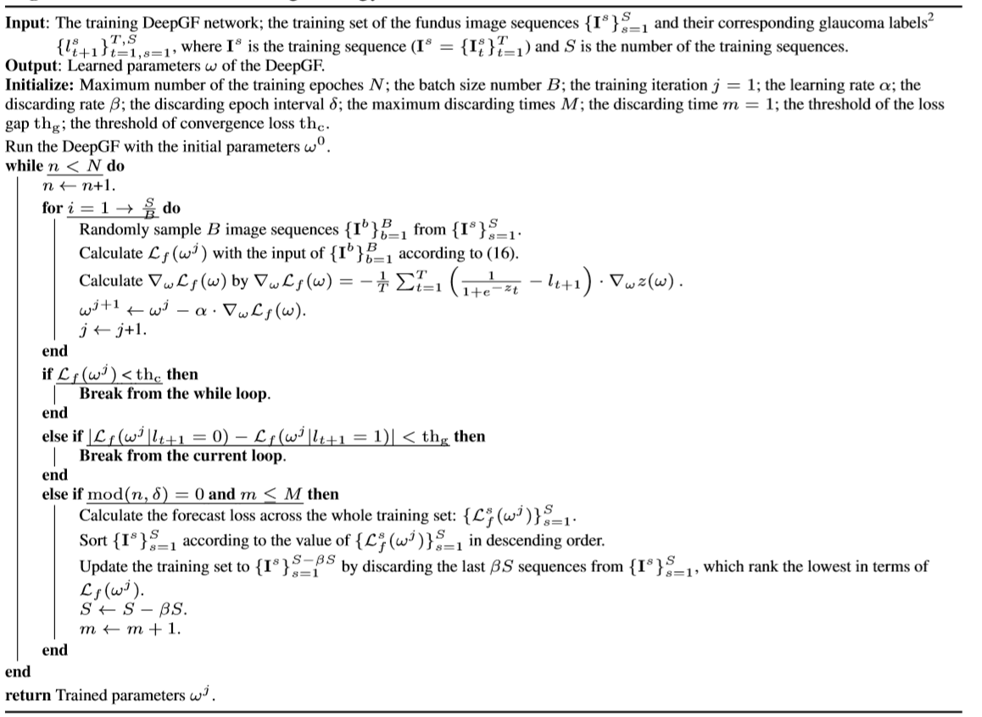
03
Method
青光眼的发病率在 45 岁以上人群中为3.5%
动态收敛策略：解决数据分布不均的问题
在训练集上计算损失值
计算各个参数的梯度值
更新网络参数
训练误差小于门限
或两类数据训练效果接近则停止训练
对样本的损失值进行排序
移除训练集中损失值小的样本
更新训练集
Notes:
自3012年起，由于机器学习的发展，它在诸多领域取得非常显著的效果，在医疗领域也有这非常重大的应用
1.机器学习的蓬勃发展
2.在诸多领域中的应用：物体检测，人脸识别，自然语言处理 siri，数据挖掘
各个领域：视频编码医疗
《Dermatologist-level classification of skin cancer with deep neural networks》

